Slide 1

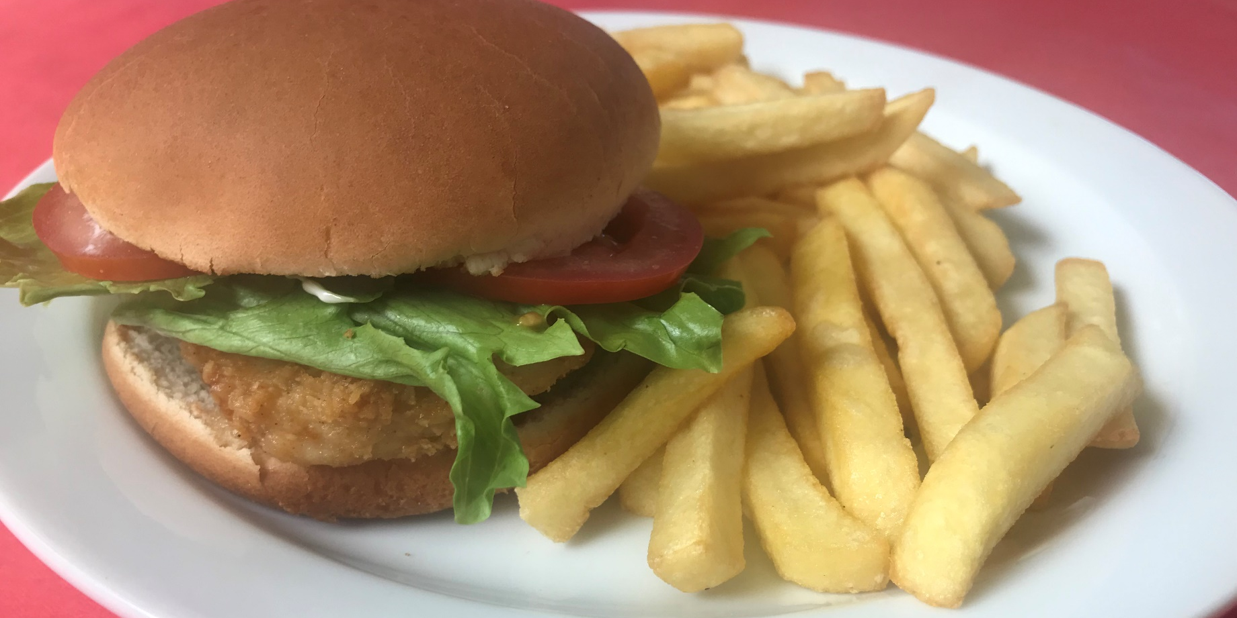
TROJANS BAR
NEW CHICKEN FILLET BURGER AND CHIPS
ONLY £3.50

Slide 2
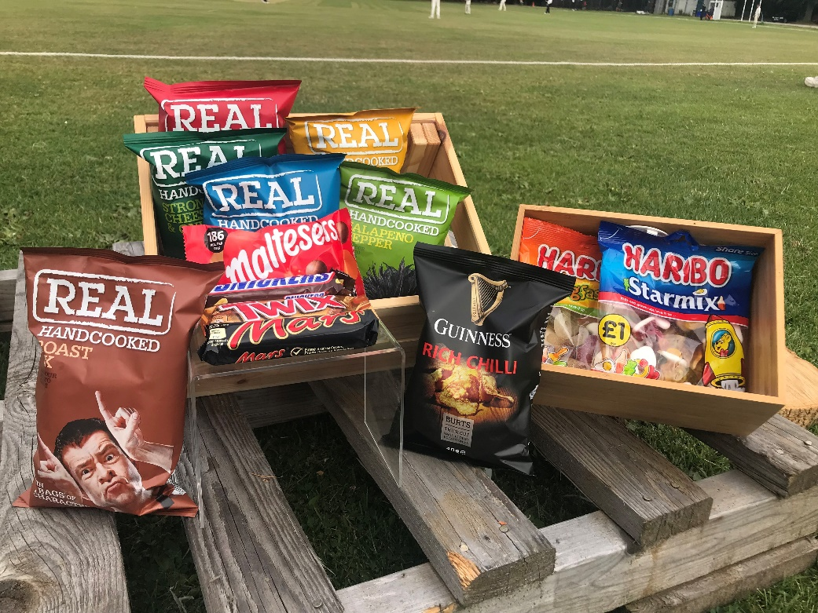
TROJANS BAR
CRISPS, CHOCOLATE AND HARIBO
A GREAT RANGE AVAILABLE
ONLY £1.00 EACH

Slide 3
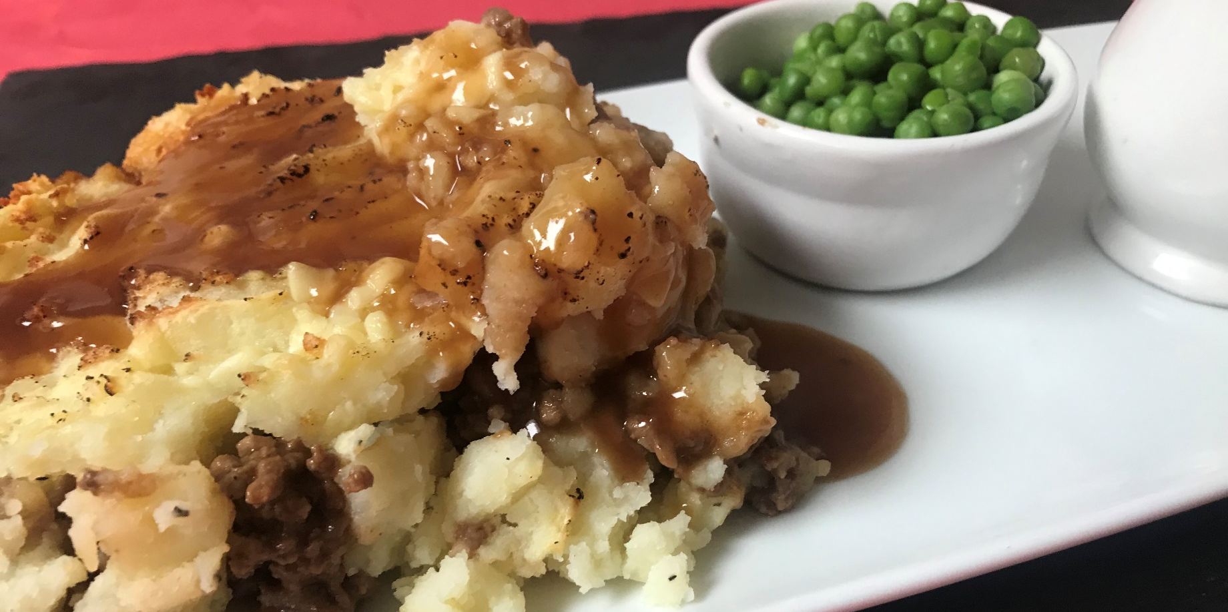
TROJANS BAR
HOMEMADE COTTAGE PIE, PEAS AND GRAVY
ONE OF OUR SPECIALS.

Slide 4
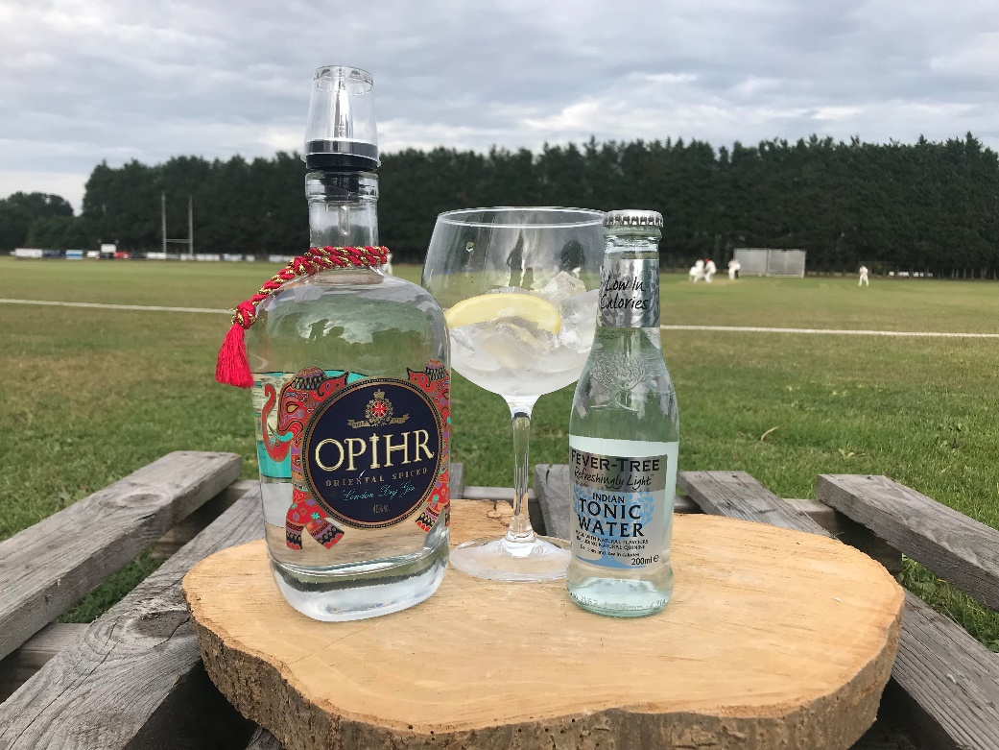
TROJANS BAR
DOUBLE UP
DOUBLE SPIRIT AND A MIXER
ONLY £5.00 EACH

Slide 5
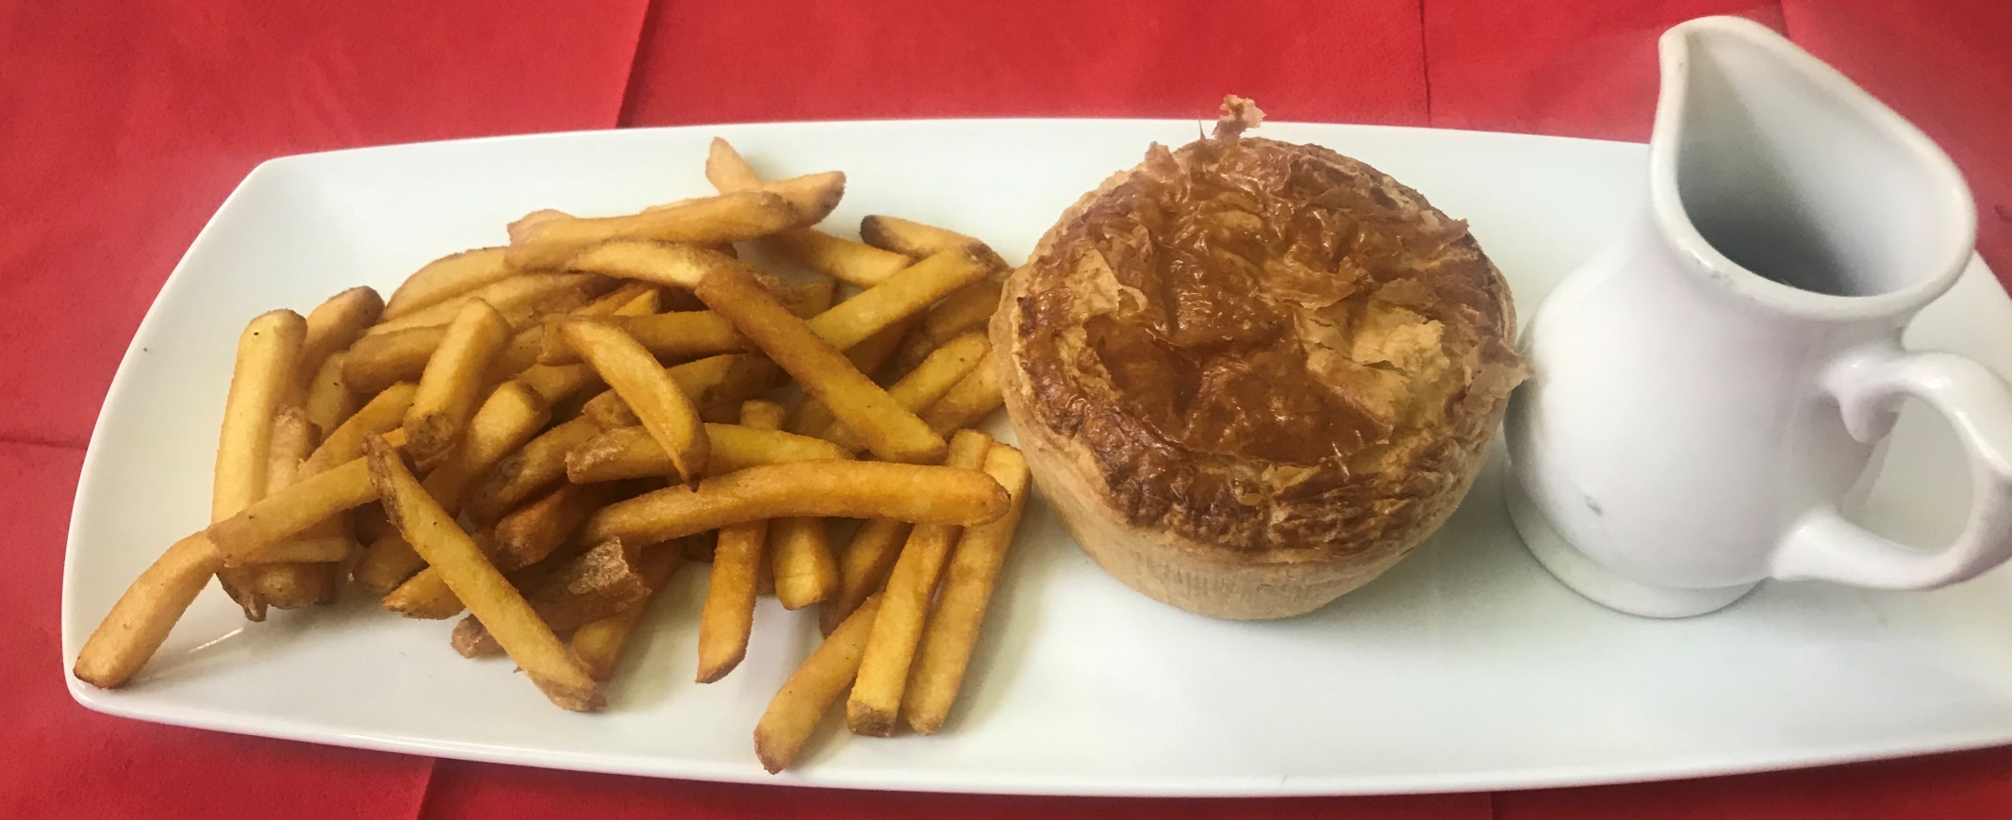
TROJANS BAR
STEAK PIE WITH SKIN ON FRIES AND GRAVY
ANOTHER GREAT SPECIAL ONLY £3.00

Slide 6
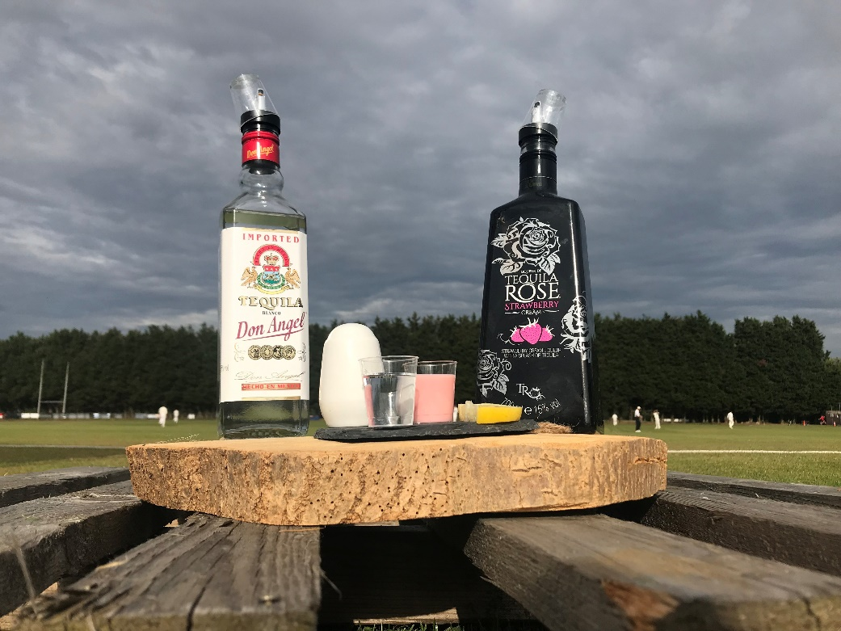
TROJANS BAR
HIT THE SHOTS
TEQUILA AND SAMBUCA
ONLY £2.00 PER SHOT

Slide 7
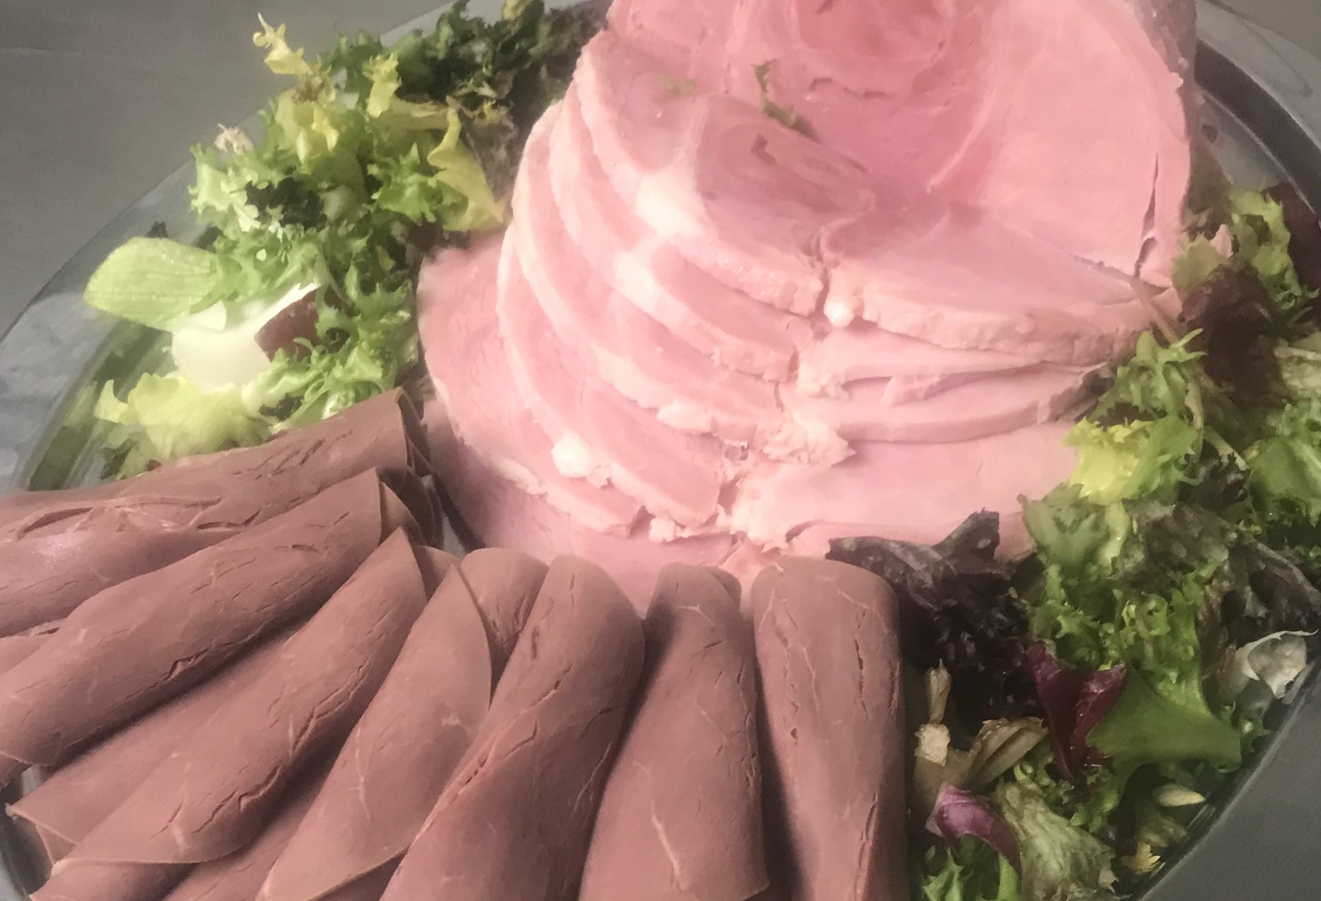
TROJANS BAR

Slide 8
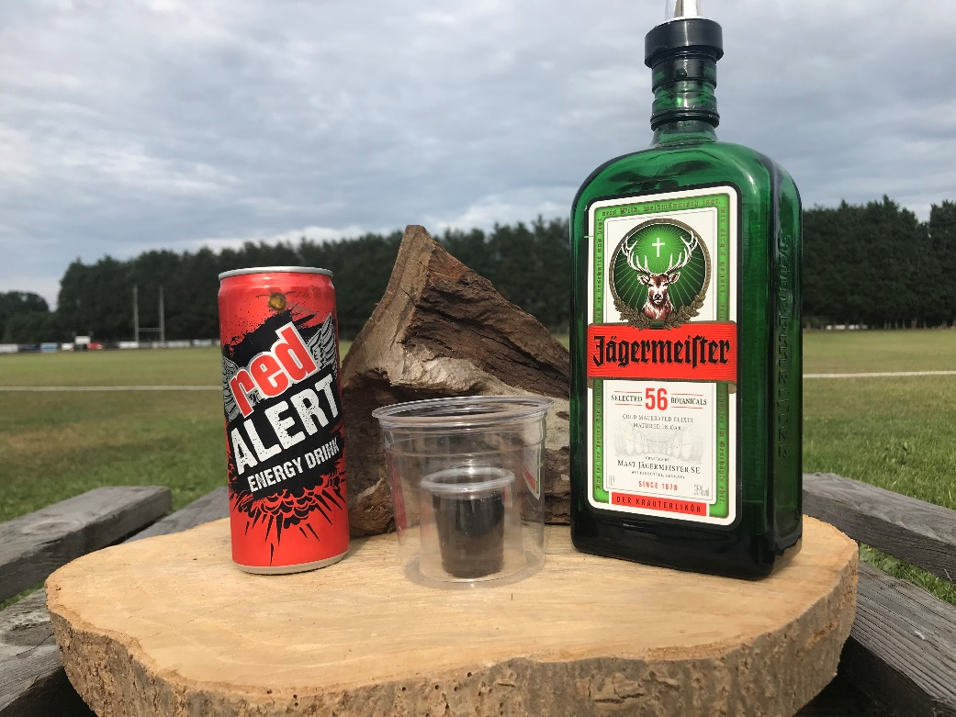
TROJANS BAR
ITS BOMB TIME
VARIOUS BOMBS AVAILABLE. ASK A MEMBER OF STAFF.
ONLY £3.00 PER BOMB

Slide 9
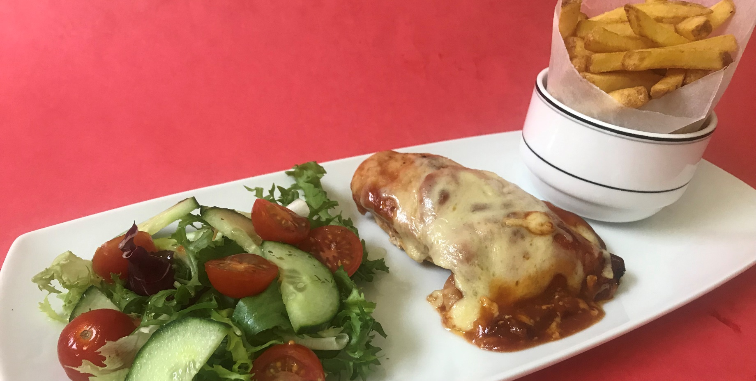
TROJANS BAR
HOMEMADE HUNTERS CHICKEN, CHIPS AND SALAD
ONLY £3.00. AVAILABLE WHEN ON SPECIAL

Slide 10
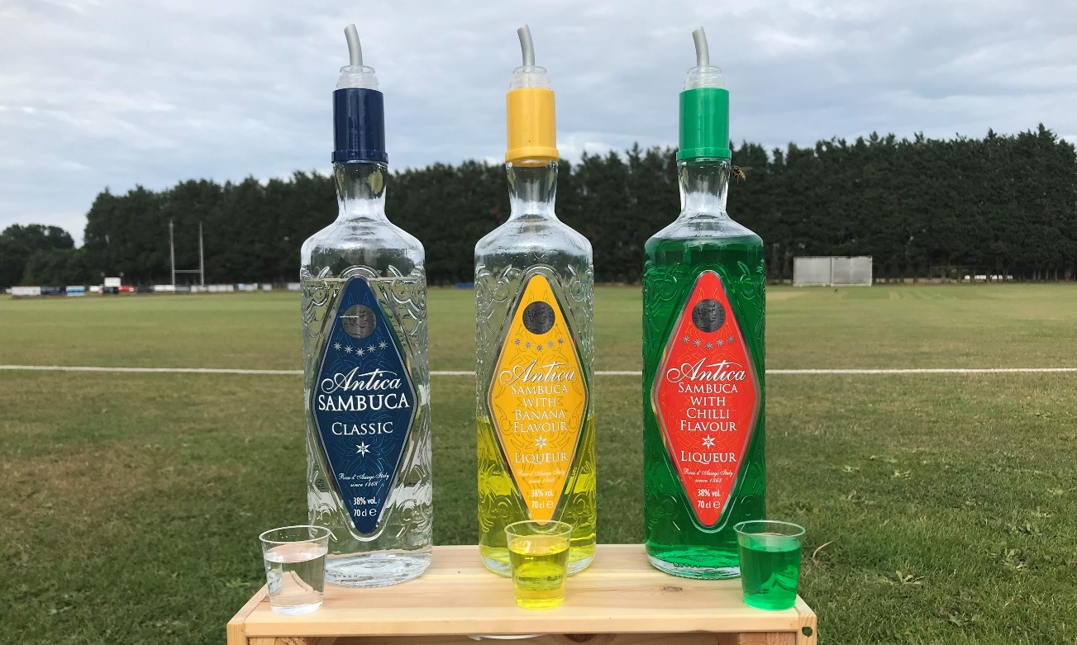
TROJANS BAR
SAMBUCA
ASK WHICH FLAVOURS WE HAVE AVAILABLE
ONLY £2.00 PER SHOT

Slide 11
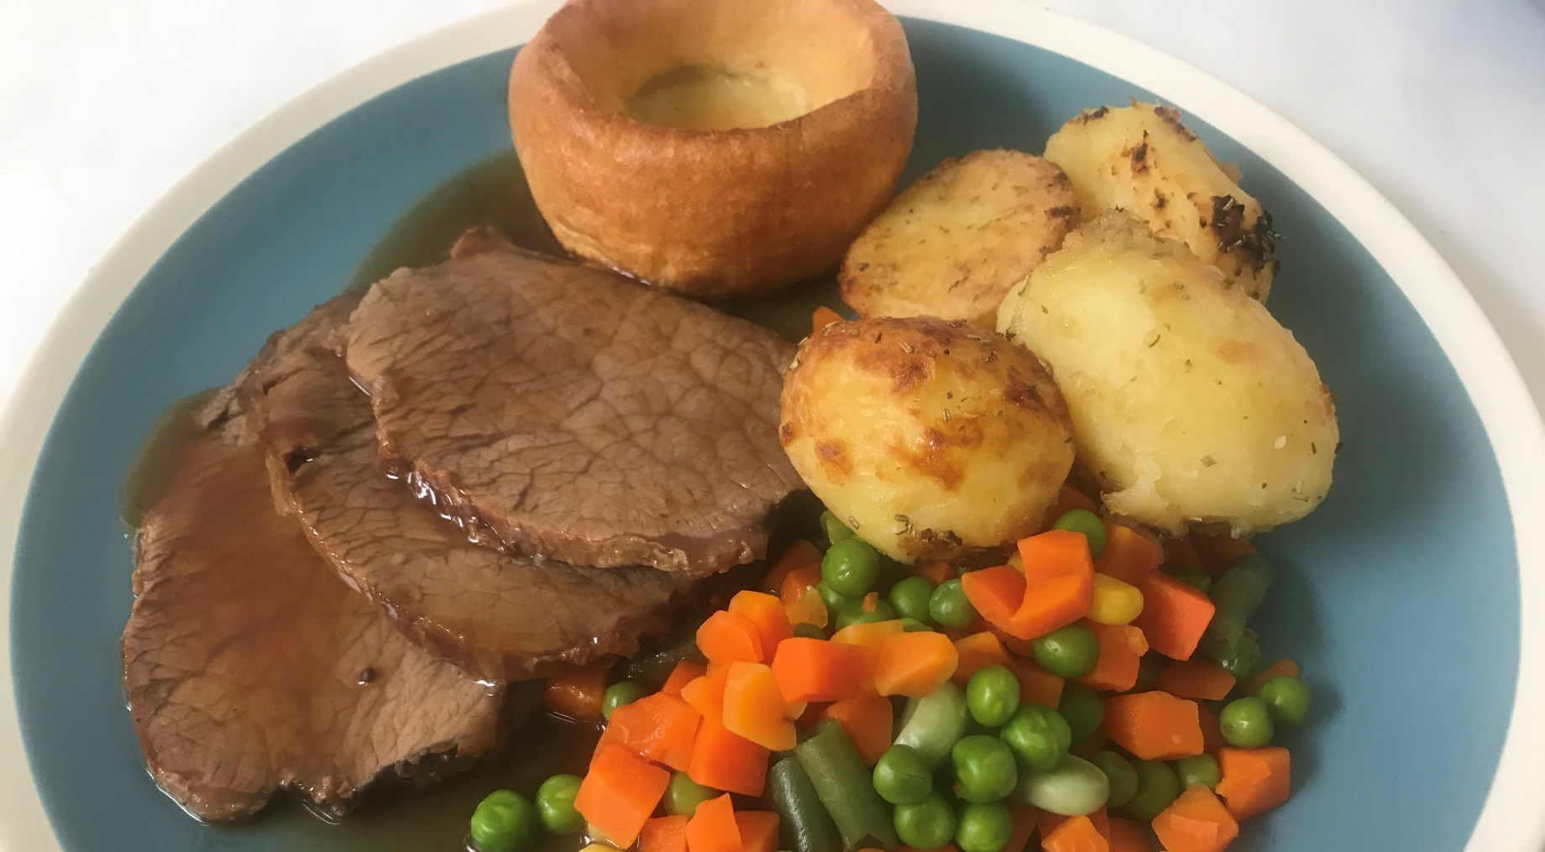
TROJANS BAR
ROAST DINNER – COMING SOON ON SUNDAYS

Slide 12
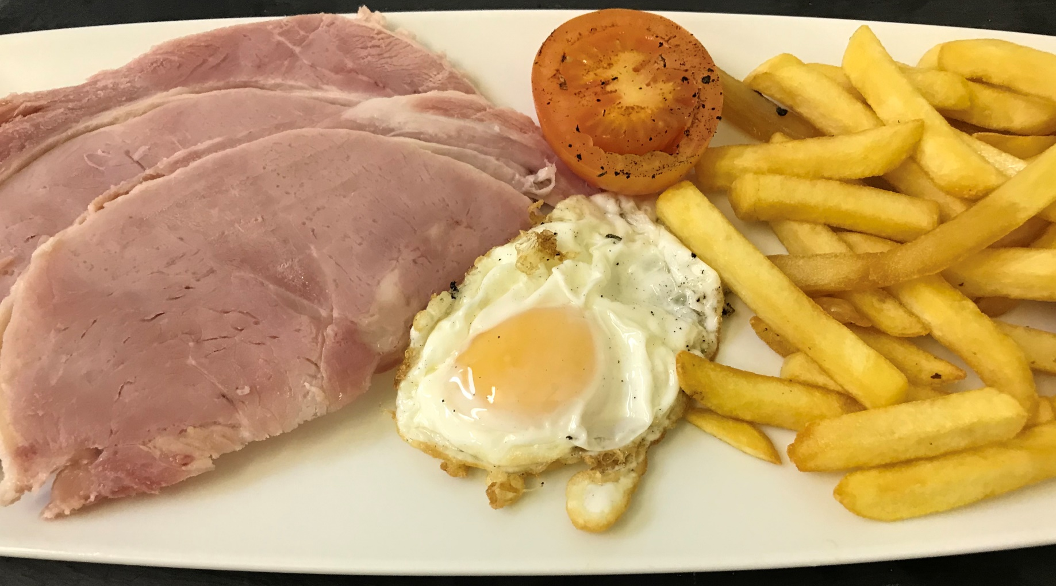
TROJANS BAR
HAND CARVED HAM, EGG AND CHIPS

